Slide 1

7.

Slide 2
Agenda
History
Mobile app testing strategy
Device selection
Delivery
Mobile apps types
Mobile testing guide
Application activity lifecycle
Mobile UX guideline
Tools

Slide 3
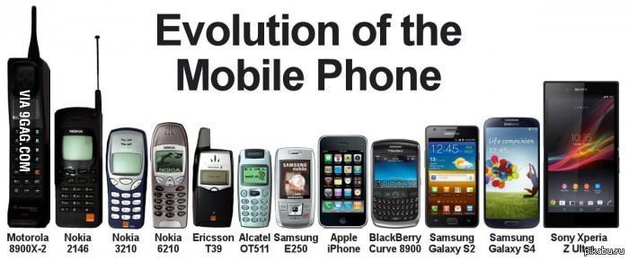
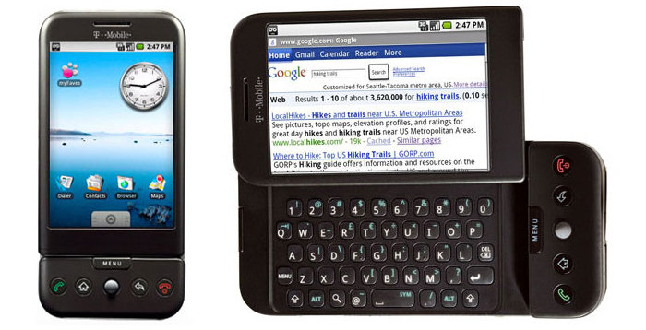
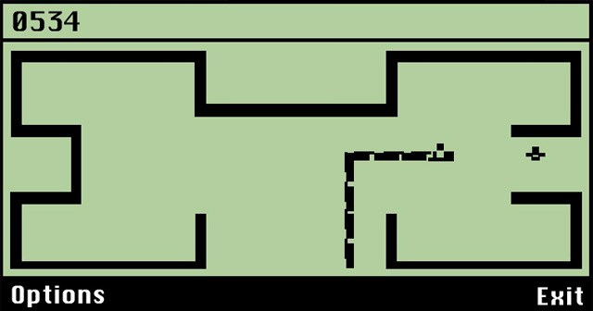
Mobile apps, development
Phone main goal – to make calls
First apps – contact book
Personal Digital Assistant (PDA) devices
Mobile become replacement for Computers
Notes:
Первые телефоны – звонилки
Мобильная революция началась с появлением первых мобильных телефонов. Они были слишком большие, чтоб носить их с собой, и единственной функцией был звонок другому человеку. Следующим шагом в развитии были текстовые сообщения, что позволяло общаться, без необходимости говорить по телефону.
Первые приложения – телефонная книга
Разработка мобильных приложений на раннем этапе представляла собой создание небольших каталогов, где вы могли хранить ваши часто набираемые номера. Для многих устройств, это было не более, чем связать 10 кнопок на мобильном телефоне с цифрами, но не именем. Как только устройства стали более прогрессивными, возможность сохранения большего количества номеров связанных с фактическими имена, была быстро востребованной. На тот момент, телефон стал напоминать телефонную книгу.
Первые приложения – Калькулятор, Календарь, Игры
Но не только простые игры сделали телефон более полезным. Первые мобильные устройства также стали включать калькуляторы, контакты и календари, смешивая телефон с персональным компьютером, предвещая падение КПК, который в то время, пользовался большой популярностью.

Slide 4
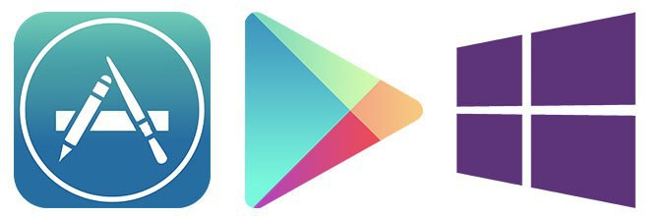
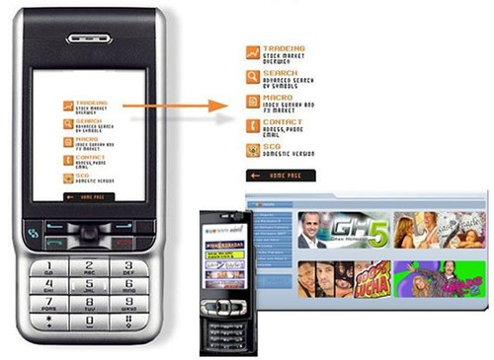
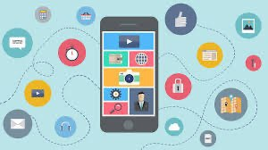
Mobile Apps, growing
First mobile protocol – WAP
Internet Marketing
App Markets
Extremely growing market
Notes:
Первый протокол - WAP
Все изменилось с введением Wireless Application Protocol (WAP) и легким (вроде как) подключением к Интернету. Теперь, пользователи могли подключиться к сети и выбрать приложения, которые были для них наиболее полезными.
Интернет-магазины
Поскольку спрос поднялся, разработчики и операторы, такие как Android и Apple, создали магазины-приложений, где пользователи могли легко и быстро находить приложения, которые хотели скачать на свой мобильный телефон. Ну, относительно легко! Теперь пользователи сами решают, что и как они хотят использовать на своей мобильной прелести. Онлайн-банкинг, покупки, видео и игры, все доступно, что позволяет почти полную пользовательскую настройку телефона.
Интернет-магазины позаботились о том, чтобы вы могли делать шоппинг на ходу. Практически для любого бизнеса и интернет- активности, теперь существует мобильное приложение.
Так как пользователи становятся все более мобильными в своих соединениях, кто знает, куда нас следующий большой прорыв приведет? Операционные системы и мобильные устройства становятся все более изощренными, так что будьте уверены, приложения будут также продолжать развиваться.
The AppStore goes live
In the month of July 2008, the Apple AppStore went live featuring over 500 apps which Steve Jobs said ‘ developers can reach every single iPhone user through AppStore.’
There were over 10 million apps downloaded in the first few days, highlighting the huge reach and potential of apps, with many of these offered free of charge or for a very low cost.
Google arrives… four years later
It took them a while, but eventually, Google launched their own version of an app store, Google Play, which housed all of the apps available for Android users. Whilst there were individual markets for Android users previously, most notably Android Market, Google Books, and Google Music, it was finally decided to merge them into one larger application store for the mass market.

Slide 5
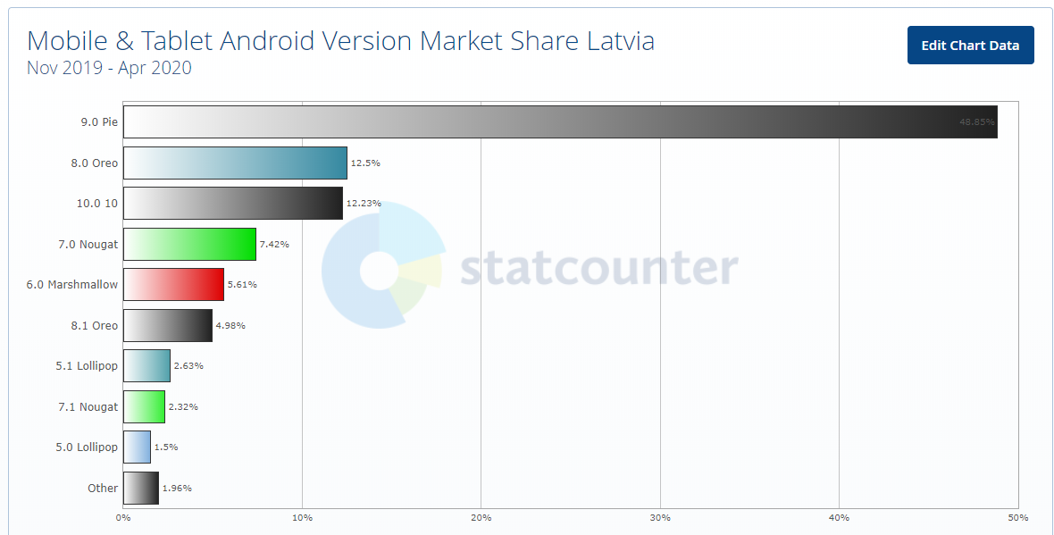
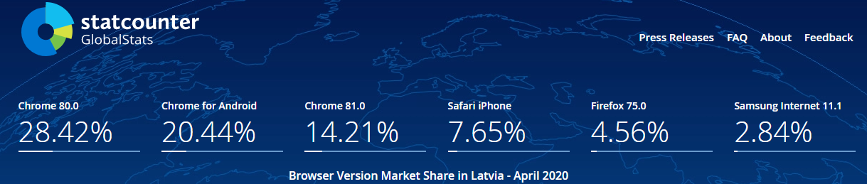
Mobile Apps, actual market
Notes:
https://gs.statcounter.com/browser-version-market-share/all/latvia/#monthly-201911-202004
Рынок мобильных приложений развивается быстрыми темпами и по прогнозам ведущих компаний рост будет увеличиваться. Появляется все больше разработчиков, компаний и самих приложений. Растет конкуренция и среди сервисов с одинаковыми функциями - кто-то берет дизайном, кто-то добавляет новые фичи, а кто-то раскручивается рекламой. Анализ рынка мобильных приложений показывает, что у 2020 году доходы от приложений достигнут 189 миллиардов долларов.
Два гиганта мобильной разработки Android и iOS доминируют на глобальном рынке смартфонов.
The number of mobile app downloads each year has been steadily increasing. In 2017, there were 178 billion app downloads. That number is projected to grow to 205 billion this year, and 258 billion in 2022—a 45 percent increase over five years.
Today, we pretty much all use at least one mobile app a day. Whether it’s checking your bank account, placing a bet on the latest round of football fixtures, shopping for an outfit for your next night on the town or looking for directions to a restaurant, there’s an app for all of the above and lots more too.

Slide 6
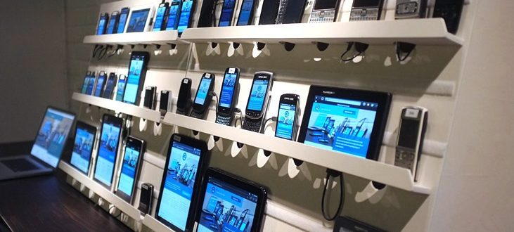
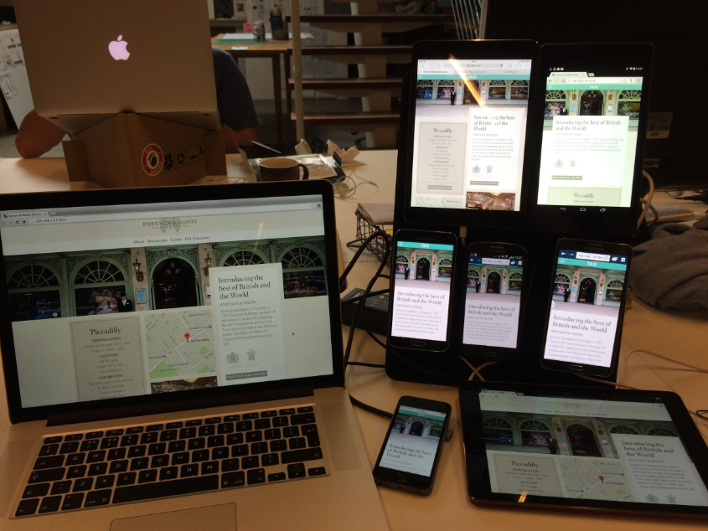
Mobile device selection
How to choose test devices:
Market shares, Popularity
Client Statistics, Requirements
Available devices on local market
Available company devices
Personal devices
Emulators
Device farms
Notes:
Mobile app delivery
Choose the right beta app management platform
Managing and delivering mobile app betas requires a management platform. The mobile OSes you support, the number of apps you plan to test, and related factors will drive your platform decision.
Apple and Google options
TestFlight (now owned by Apple) for iOS, TVos, and WatchOS enables you to manage beta-testing for up to 100 apps in your Apple Developer Account. It lets you prepare your app for beta and invite testers through iTunes Connect.
Google Play Developer Console supports Android and Android Wear only. It allows you to run open betas, closed betas by email address, and closed betas with Google+ Community or Google Group. Beta apps are made available via Google Play. It’s important to note that beta-testers require a Gmail or Google Apps account to join your betas. Testers can’t leave public reviews of betas on Google Play, so you’ll need to provide an online channel for testers to send beta feedback.
Managing and delivering mobile app betas requires a management platform. The mobile OSes you support, the number of apps you plan to test, and related factors will drive your platform decision.
Apple and Google options
TestFlight (now owned by Apple) for iOS, TVos, and WatchOS enables you to manage beta-testing for up to 100 apps in your Apple Developer Account. It lets you prepare your app for beta and invite testers through iTunes Connect.
Google Play Developer Console supports Android and Android Wear only. It allows you to run open betas, closed betas by email address, and closed betas with Google+ Community or Google Group. Beta apps are made available via Google Play. It’s important to note that beta-testers require a Gmail or Google Apps account to join your betas. Testers can’t leave public reviews of betas on Google Play, so you’ll need to provide an online channel for testers to send beta feedback.

Slide 7
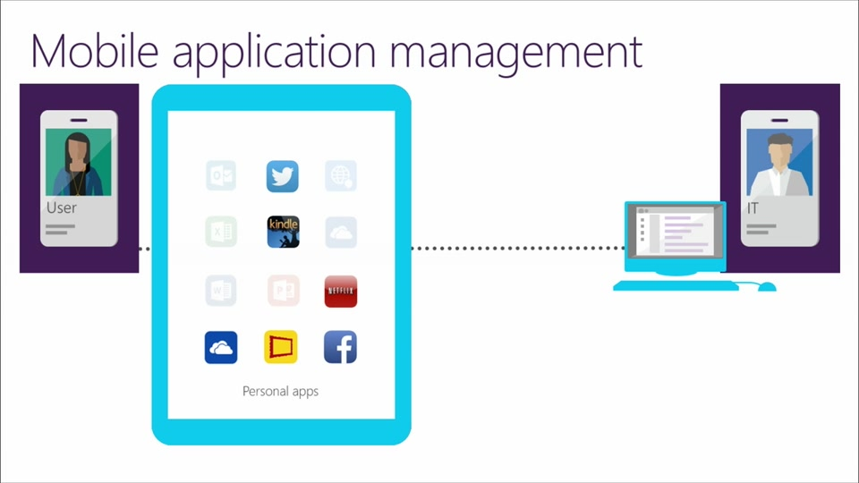
MAM – mobile delivery
Delivery on test devices
TestFlight, HockeyApp, Fabric by Twitter, Beta by Crashlytics, and TestFairy are the most popular tools in the category "Beta Testing / Mobile App Distribution".
"Must have for iOS development" is the primary reason developers pick TestFlight over its competitors, while "Crash analytics" is the reason why HockeyApp was chosen.
Notes:
Mobile app delivery
Choose the right beta app management platform
Managing and delivering mobile app betas requires a management platform. The mobile OSes you support, the number of apps you plan to test, and related factors will drive your platform decision.
Apple and Google options
TestFlight (now owned by Apple) for iOS, TVos, and WatchOS enables you to manage beta-testing for up to 100 apps in your Apple Developer Account. It lets you prepare your app for beta and invite testers through iTunes Connect.
Google Play Developer Console supports Android and Android Wear only. It allows you to run open betas, closed betas by email address, and closed betas with Google+ Community or Google Group. Beta apps are made available via Google Play. It’s important to note that beta-testers require a Gmail or Google Apps account to join your betas. Testers can’t leave public reviews of betas on Google Play, so you’ll need to provide an online channel for testers to send beta feedback.
Managing and delivering mobile app betas requires a management platform. The mobile OSes you support, the number of apps you plan to test, and related factors will drive your platform decision.
Apple and Google options
TestFlight (now owned by Apple) for iOS, TVos, and WatchOS enables you to manage beta-testing for up to 100 apps in your Apple Developer Account. It lets you prepare your app for beta and invite testers through iTunes Connect.
Google Play Developer Console supports Android and Android Wear only. It allows you to run open betas, closed betas by email address, and closed betas with Google+ Community or Google Group. Beta apps are made available via Google Play. It’s important to note that beta-testers require a Gmail or Google Apps account to join your betas. Testers can’t leave public reviews of betas on Google Play, so you’ll need to provide an online channel for testers to send beta feedback.

Slide 8
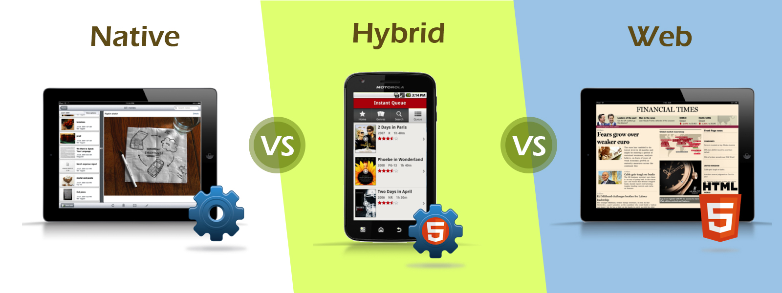
Types of mobile apps

Slide 9


Web app
Mobile Web application, in fact, is the website opened in the gadget (smartphone or tablet) with the help of the mobile browser.
- Easy development
- Easy access
- Easy update
- Mobile Web App requires no installation
- No offline capabilities support.
- Limited functionality in the comparison with Hybrid and Native Apps. (no access to the file system and local resources).

Slide 10
Native app
Native App is the application, which has been developed specifically for one platform (Android, iOS, Windows 10, BlackBerry).
- Works offline
- Can use all features of its device
- Advanced user experience
- Push notifications can be used for users alert
- Creation is expensive in comparison to the Mobile Web apps
- Requires high costs for the maintenance

Slide 11
Hybrid app
Hybrid App is the mix of the Native App and Mobile Web App. It can be defined like mobile website content exposition in the application format.
- More cost effective in comparison to the Native App
- Easy distribution
- Embedded browser
- Device features
- Works not so fast as Native App.
- Graphics are less accustomed to the OS in comparison to Native App.

Slide 12
Common aspects (platforms, devices, orientation, pixel perfect, external modules, target)
Analysis by app pages (requests, timers, cache, refresh)
Controls (SF, HW)
Permissions
Lists, Pagination (lazy loading, filters, sorting)
Social Networks interaction
Device specific, Interruptions (on/off/lock, call, alarm, flightmode, bluetooth)
Notifications
Mobile Testing Guide
Notes:
https://docs.google.com/document/d/1s-zBN8V7cIspP8DKJdV1NUYbZIkgdX9BL97oukApsyo/edit#

Slide 13
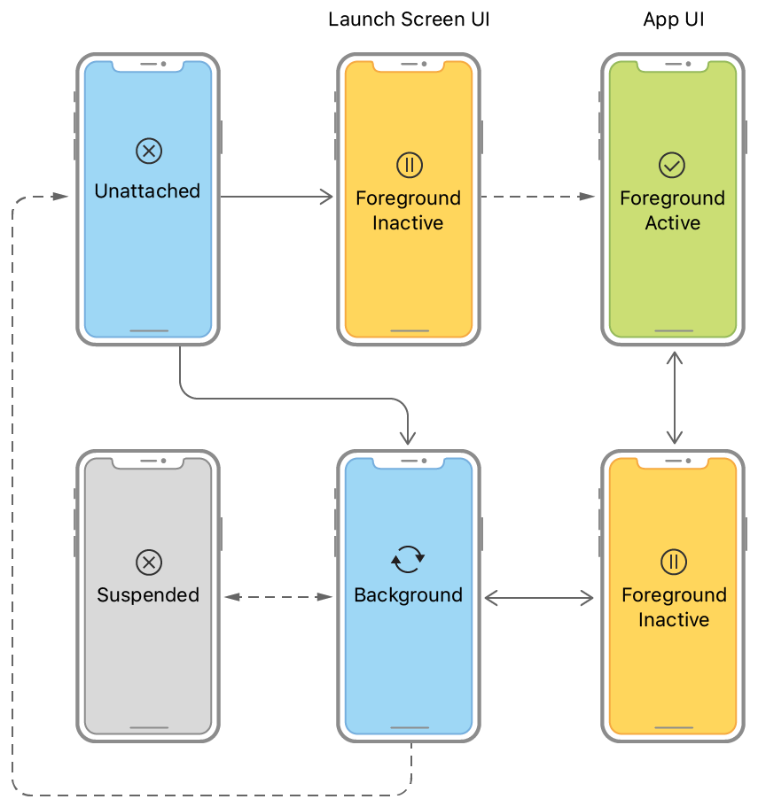
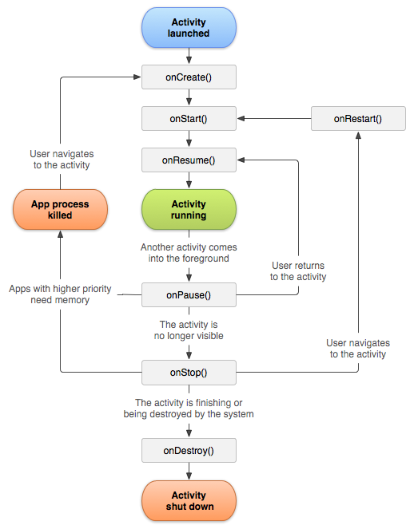
Application Activity Lifecycle
Notes:
The current state of your app determines what it can and cannot do at any time. For example, a foreground app has the user’s attention, so it has priority over system resources, including the CPU. By contrast, a background app must do as little work as possible, and preferably nothing, because it is offscreen. As your app changes from state to state, you must adjust its behavior accordingly.

Slide 14
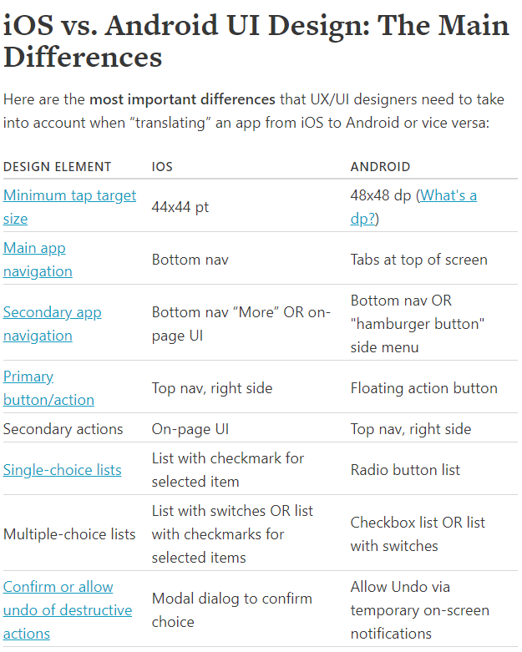
Mobile UI/UX guidelines
Notes:
Apple and Google are both very smart companies with a zillion users each.
They will make UX mistakes like anyone else, but in general, when they define a design language for the default way in which their system should work, they’re not going to be making incredibly glaring mistakes. So while I present two ways of doing everything below (the iOS way and the Android way), neither is wrong. If your users are able to confidently navigate and use the app you’re creating, then no one can tell you not to use tabs on iOS or modal views on Android.

Slide 15
Mobile testing Tools
Charles
Wireshark
Fiddler
Browser DevTools Emulator
ADBa
IDE
Simulators or Emulators
Cloud based Farms

Slide 16
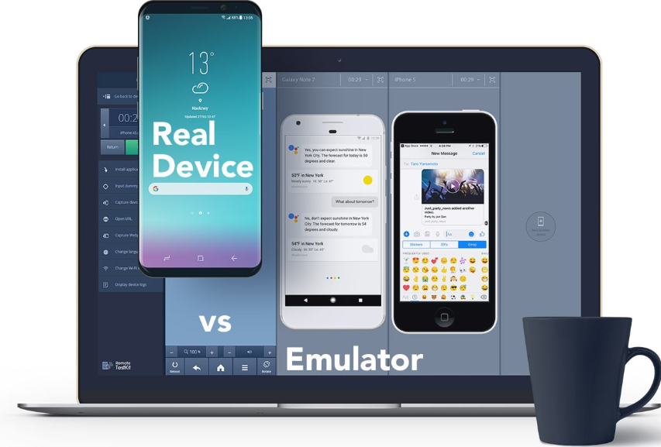
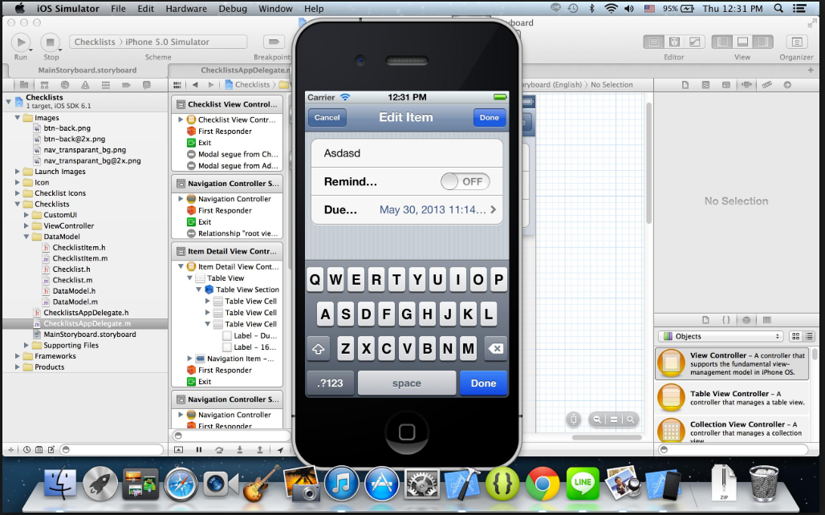
Emulators and Simulators
Emulators/simulators are special tools, which emulate/simulate functionality and behavior of mobile devices.
Emulator is the original device replacement. Though you can run soft and apps on your gadget, you have no ability to modify them. Emulators are more appropriate for the mobile site testing.
Simulator doesn't replicate device's hardware, but you have an ability to set up the similar environment as the original device’s OS. So, it is better to use mobile simulators to test mobile application.

Slide 17

Cloud-based testing of mobile app
Main advantages of this approach:
+ Easy availability.
+ An ability to run mobile devices on multiple systems and networks.
+ An ability not only to test, but also update and manage apps in the cloud.
+ Cost effective.
+ High scalability.
+ The same script can be run on several devices in parallel.
Some weak points:
- Less of the control.
- No so high level of the security.
- Dependence of the Internet connection.

Slide 18
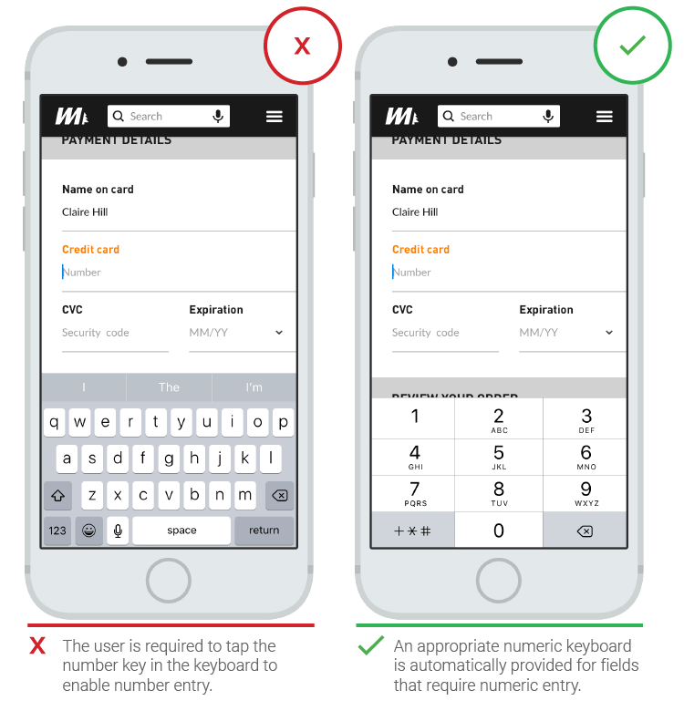
Bugs in mobile apps: example

Slide 19
HomeWork 7
Потестировать мобильное приложение Wase для любой из платформ - IOS\Android, используя чеклист, приведенный ниже.
Составьте на основе данного общего чеклиста, список проверок для приложения навигатора - Wase для любой из мобильных операционных систем(Android or IOS) и любого девайса (можно использовать ваш личный девайс).
Главная задача понять специфику мобильных приложений, и научиться понимать особенности платформы и работать с основными функциями девайса и операционной системы.
1. Составить чеклист
2. Пройти по чеклисту и проставить статусы pass\fail\blocked
3. В случае статуса fail - надо завести баги в джиру и написать в табличку
4. В случае blocked надо написать комментарий почему прохождение проверки заблокировано.
5. Результатом работы должен быть тест репорт в джире с статусами и всеми заведенными багами.
Учтите, что работа будет в одном проекте, командная.
Смотрите какие баги уже были заведены, заводить одинаковые баги не стоит. Дополняйте, перепроверяйте существующие баги на разных платформах.
Notes:
http://87.246.137.196:8081/secure/RapidBoard.jspa?rapidView=129&projectKey=QAOL&view=planning&selectedIssue=QAOL-3&issueLimit=100
Джира:
Как создавать чеклист на примере
Как в чеклисте создать табличку
Как добавить комментарии в тикет
Как ассайнить
Как линковать
Поиск и фильтра
Типы тикетов и Воркфлоу

